Slide 1

Arrays
Lesson #8

Slide 2
Korn Shell Array
Single demensional arrays ONLY
Total of 1,024 Items
Subscript range 0 - 1,023
No GLOBAL array capability
  Create array(s) within required script memory
  Format:
    set -A array name $( < datafile pathname )

Slide 3
Korn Shell Array
Syntax:
  ${ array_name [ subscript ] }
  ${ array_name [ * ] }
  ${ # array_name [ * ] }

Slide 4
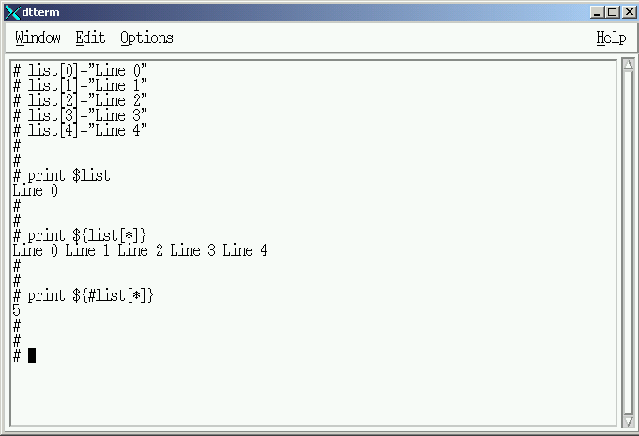

Array Creation / Verification
list
[0] Line 0
[1] Line 1
[2] Line 2
[3] Line 3
[4] Line 4

Slide 5
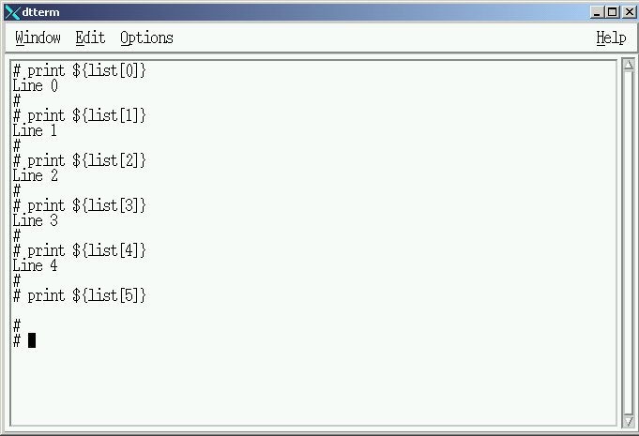
Array Usage
list
[0] Line 0
[1] Line 1
[2] Line 2
[3] Line 3
[4] Line 4

Slide 6
Creating an Array in Memory
$ cat create_array
for input in 1 2 3 4 5
do
print "Enter Name: \c"
read name[$input]
done
print "\n \n"
print "Array Entries = `echo ${ name [ * ] }`"
print "\n \n"
print "Total Array Entries = `echo ${ #name [ * ] }`"

Slide 7
Shellscript Execution
$ create_array
Enter Name: First Name
Enter Name: Second Name
Enter Name: Third Name
Enter Name: Fourth Name
Enter Name: Fifth Name
Array Entries = First Name Second Name Third Name Fourth Name Fifth Name
Total Array Entries = 6
#
Five records PLUS slot 0

Slide 8
Memory Arrays are LOCAL
$ echo ${ name [ 0 ] }
$ echo ${ name [ * ] }
$
Memory Arrays are available ONLY to the Shell executing the script
Arrays used by multiple scripts must be saved on disk files

Slide 9
Storing Memory Array on Disk
$ cat store_array
for input in 1 2 3 4 5
do
print "Enter Name: \c"
read name[$input]
echo ${ name [ $input ] } >> . /datafile
done
print "\n \n"
print "Array Entries = `echo ${ name [ * ] }`"
print "\n \n"
print "Total Array Entries = `echo ${ #name [ * ] }`”

Slide 10
Shellscript Execution
$ store_array
Enter Name: First Name
Enter Name: Second Name
Enter Name: Third Name
Enter Name: Fourth Name
Enter Name: Fifth Name
Array Entries = First Name Second Name Third Name Fourth Name Fifth Name
Total Array Entries = 6
#
Five records PLUS slot 0

Slide 11
Array Storage on Disk Verification
$ echo ${ #name [ * ] }
$ echo ${ name [ * ] }
$ ls -l datafile
-rw-r--r-- 1 root staff 57 Apr 2 14:04 datafile
$
$ cat datafile
First name
Second name
Third name
Fourth name
Fifth name
$

Slide 12
Load/Display Memory Array
$ cat display_array
print "Array being created"
set -A name $( < ./datafile )
print "Array created"
sleep 5
### Display Memory Array Routine
for input in 1 2 3 4 5
do
echo ${name[$input]}
done
$

Slide 13
Shellscript Execution
$ display_array
Array being created
Array created
name
second
name
third
name
#
Problem

Slide 14

Loading Memory Arrays
datafile
Memory ARRAY
Disk
name
[0] First
[1] Name
First Name
[2] Second
Second Name
[3] Name
Third Name
[4] Third
Fourth Name
[5] Name
Fifth Name

Slide 15
Load/Display Memory Array
$ cat display_array
print "Array being created"
set -A name $( < ./datafile )
print "Array created"
sleep 5
### Display Memory Array Routine
for input in 1 2 3 4 5
do
echo ${name[$input]}
done
$

Slide 16
Storing Memory Array on Disk
$ cat store_array_2
for input in 1 2 3 4 5
do
print "Enter Name: \c"
read name[$input]
echo ${ name [ $input ] } >> . /datafile
done
print "\n \n"
print "Array Entries = `echo ${ name [ * ] }`"
print "\n \n"
print "Total Array Entries = `echo ${ #name [ * ] }`”
sed “s/ / ! / “ datafile > tempfile
rm datafile ; mv tempfile datafile

Slide 17
Shellscript Execution
$ store_array_2
Enter Name: First Name
Enter Name: Second Name
Enter Name: Third Name
Enter Name: Fourth Name
Enter Name: Fifth Name
Array Entries = First Name Second Name Third Name Fourth Name Fifth Name
Total Array Entries = 6
#
Five records PLUS slot 0

Slide 18
Resulting Disk File
$ cat datafile
first!name
second!name
third!name
fourth!name
fifth!name
$

Slide 19
Loading Memory Arrays
datafile
Disk
Memory ARRAY
Memory ARRAY
name
name2
First!Name
[0] First!Name
[0] First Name
Second!Name
[1] Second!Name
[1] Second Name
Third!Name
[2] Third!Name
[2] Third Name
Fourth!Name
[3] Fourth!Name
[3] Fourth Name
Fifth!Name
[4] Fifth!Name
[5] Fifth Name

Slide 20
Load/Display Memory Array
$ cat display_array_2
print "Array being created"
set -A name $( < ./datafile )
for input in 0 1 2 3 4
do
name2[$input] = `echo ${name[$input]} | sed “ s/ ! / / ” `
done
print "Array created"

Slide 21
Load/Display Memory Array
### Display Memory Array Routine
for input in 0 1 2 3 4
do
echo ${name2[$input]}
done
$

Slide 22
Shellscript Execution
$ display_array_2
Array being created
Array created
first name
second name
third name
fourth name
fifth name
$

Slide 23
Multiple Arrays

Slide 24
Multiple Arrays
Create a script to prompt the operator to enter “name”, “city” and “state” via the keyboard.
Each field will be stored in a memory array appropriately named. (ie: city_array)
Each field will be written from the memory array to an appropriately named disk file.
(ie: city_data)

Slide 25
Multiple Arrays
Total of Five Records with all three fields will be created
After each memory array has been created the operator will be shown:
  All data stored in the array
  Number of records within the array

Slide 26

Memory Arrays
name_array
city_array
state_array
[0] First Name
[0] First City
[0] First State
[1] Second Name
[1] Second City
[1] Second State
[2] Third Name
[2] Third City
[2] Third State
[3] Fourth Name
[3] Fourth City
[3] Fourth State
[4] Fifth Name
[4] Fifth City
[4] Fifth State

Slide 27
Disk Files
name_data
city_data
state_data
First!Name
First!City
First!State
Second!Name
Second!City
Second!State
Third!Name
Third!City
Third!State
Fourth!Name
Fourth!City
Fourth!State
Fifth!Name
Fifth!City
Fifth!State

Slide 28
Name Array Creation/Storage
# cat store_array_3
input=0
for input in 0 1 2 3 4
do
print "Enter Name: \c"
read name[$input]
#
echo ${ name [ $input ] } >> . /name_data
#
done
print "\n \n"
print "Array Entries = `echo ${ name [ * ] }`"
print "\n \n"
print "Total Array Entries = `echo ${ #name [ * ] }`“

Slide 29
City Array Creation/Storage
for input in 0 1 2 3 4
do
print "Enter City: \c"
read city[$input]
#
echo ${ city [ $input ] } >> . /city_data
#
done
print "\n \n"
print "Array Entries = `echo ${ city [ * ] }`"
print "\n \n"
print "Total Array Entries = `echo ${ #city [ * ] }`“

Slide 30
State Array Creation/Storage
for input in 0 1 2 3 4
do
print "Enter State: \c"
read state[$input]
#
echo ${ state [ $input ] } >> ./state_data
#
done
print "\n \n"
print "Array Entries = `echo ${ state [ * ] }`"
print "\n \n"
print "Total Array Entries = `echo ${ #state [ * ] }`“

Slide 31
Disk File Modifications
sed "s/ / ! /" name_data > nametmp
sed "s/ / ! /" city_data > citytmp
sed "s/ / ! /" state_data > statetmp
rm name_data city_data state_data
mv nametmp name_data
mv citytmp city_data
mv statetmp state_data

Slide 32
Shellscript Execution
$ store_array_3
Enter Name: First Name
Enter Name: Second Name
Enter Name: Third Name
Enter Name: Fourth Name
Enter Name: Fifth Name
Array Entries = First Name Second Name Third Name Fourth Name Fifth Name
Total Array Entries = 5

Slide 33
Shellscript Execution
Enter City: First City
Enter City: Second City
Enter City: Third City
Enter City: Fourth City
Enter City: Fifth City
Array Entries = First City Second City Third City Fourth City Fifth City
Total Array Entries = 5

Slide 34
Shellscript Execution
Enter State: First State
Enter State: Second State
Enter State: Third State
Enter State: Fourth State
Enter State: Fifth State
Array Entries = First State Second State Third State Fourth State Fifth State
Total Array Entries = 5
$

Slide 35
Disk Storage Verifications
$ cat name_data
First!Name
Second!Name
Third!Name
Fouth!Name
Fifth!Name
$
$ cat city_data
First!City
Second!City
Third!City
Fourth!City
Fifth!City

Slide 36
Disk Storage Verification
$ cat state_data
First!State
Second!State
Third!State
Fourth!State
Fifth!State
$

Slide 37
Loading Arrays from Disk
Create a script to create three memory arrays using the three disk files just created.

Slide 38
Multiple Arrays
Display a line containing the FIRST record
from EACH array, lined up under an appropriate heading.
Repeat the process for all FIVE records in the memory arrays.

Slide 39
Disk Files
name_data
city_data
state_data
First!Name
First!City
First!State
Second!Name
Second!City
Second!State
Third!Name
Third!City
Third!State
Fourth!Name
Fourth!City
Fourth!State
Fifth!Name
Fifth!City
Fifth!State

Slide 40
Disk Data Created Arrays
Memory ARRAYS
Name array
City array
State array
First!Name
First!City
First!State
Second!Name
Second!City
Second!State
Third!Name
Third!City
Third!State
Fourth!Name
Fourth!City
Fourth!State
Fifth!Name
Fifth!City
Fifth!State

Slide 41
Modified Memory Arrays
name2_array
city2_array
state2_array
[0] First Name
[0] First City
[0] First State
[1] Second Name
[1] Second City
[1] Second State
[2] Third Name
[2] Third City
[2] Third State
[3] Fourth Name
[3] Fourth City
[3] Fourth State
[4] Fifth Name
[4] Fifth City
[4] Fifth State

Slide 42
Array Creation & Display
$ cat display_array_3
set -A name $( < ./name_data)
set -A city $(< ./city_data)
set -A state $(< ./state_data)
#
for input in 0 1 2 3 4
do
name2[$input]=`echo ${name[$input]} | sed "s/ ! / /"`
city2[$input]=`echo ${city[$input]} | sed "s/ ! / /"`
state2[$input]=`echo ${state[$input]} | sed "s/ ! / /"`
done

Slide 43
Array Creation & Display
# Display Memory Array Routine
#
print "\t Name \t\t\t City \t\t\t State \n\n"
for input in 0 1 2 3 4
do
print "\t ${name2[$input]} \t\t ${city2[$input]} \t\t ${state2[$input]} "
done
$

Slide 44
Multiple Arrays
$ display_array_3
Name City State
first name first city first state
second name second city second state
third name third city third state
fourth name fourth city fourth state
fifth name fifth city fifth state
$

Slide 45
Arrays
Lesson #8 - Completed

